Slide 1

INTRODUCTION
PATIENT’S PROFILE, MEDICAL CASE AND CARE PATH

Slide 2

Patient’s Situation
50 years old male Patient is complaining of Dyspnea which in other words refer to shortness of breath. The patient admitted that he had tested positive for Covid-19 seven days ago. The Patient is admitted to telemetry for ongoing management.

Slide 3

Background
From the previous health records, it is determined that the patient has history of hypertension, hyperlipidemia and child hood asthma.

Slide 4

Background cont’d
It has also been determined that the patient has a history of development and cognitive delay, Anxiety and pre-diabetes. Further, the patient does not have any history of smoking.

Slide 5
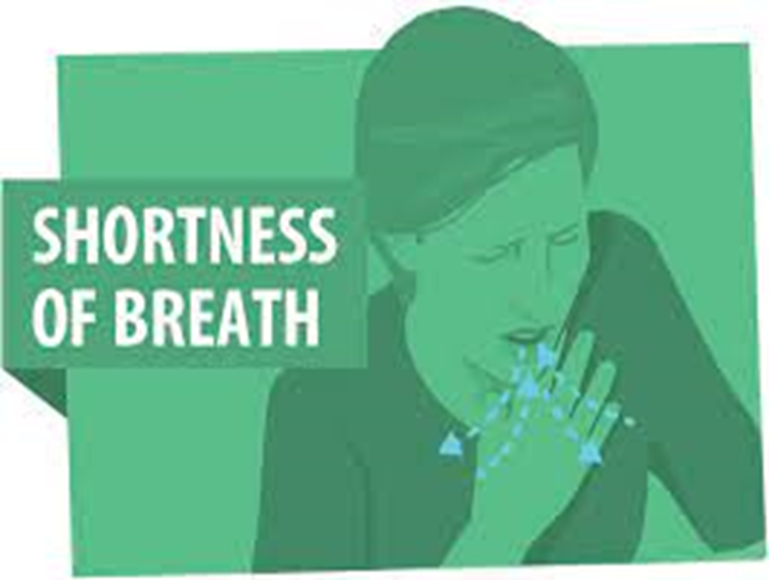
Background cont’d
The events that led to the patient’s current hospitalization are that;
In the last four days the patient noted increased shortness in breath.
He reported that the shortness in breath mostly happened when he was showering. He patient also admitted that he had tested positive for Covid-19 seven days ago.

Slide 6

Background cont’d
However, the patient denied to experience any
Chest pains
Abdominal pain
Nausea
Vomiting
Diarrhea

Slide 7
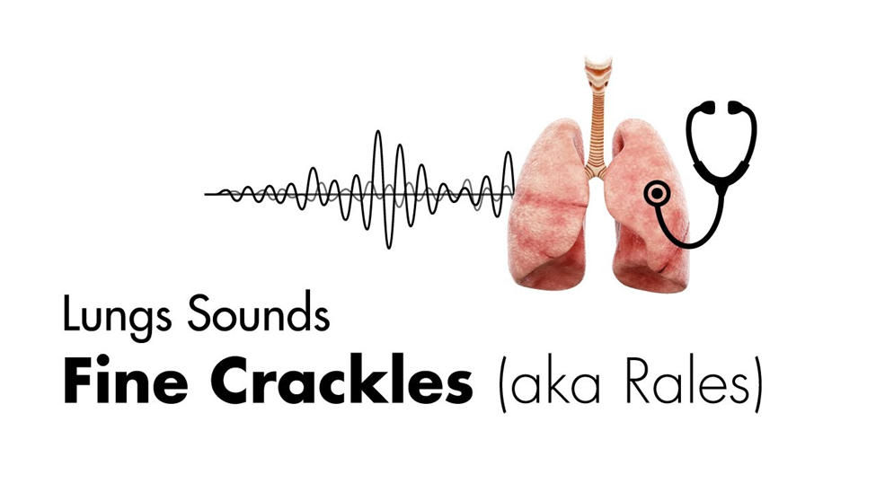
Assessment
After the assessment, there wasn’t any erythema or exudate found at the left internal jugular central line. The assessment found that the patient exhibited diminished breath sounds with ventilator sounds.
Further, it was found that the patent has Ronchi in right and left lung.
additionally, the patient has equal bilateral symmetrical excursion in the chest.
However, the patient does not have subcutaneous emphysema.

Slide 8
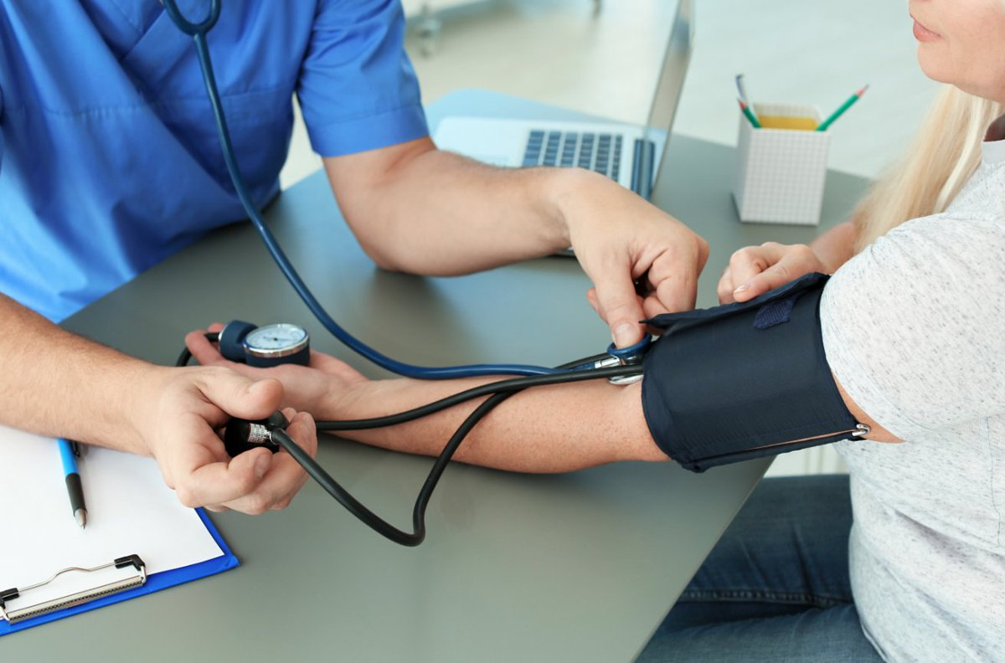
Assessment cont’d
The vital signs that were found on the patient after the assessment were patients pressure at 112/75, Pulse at 69, Temperature at 36.3 degrees Celsius, Respiration rate at 32BPM, Height at168cm, and Weight at 70.3kgs.

Slide 9
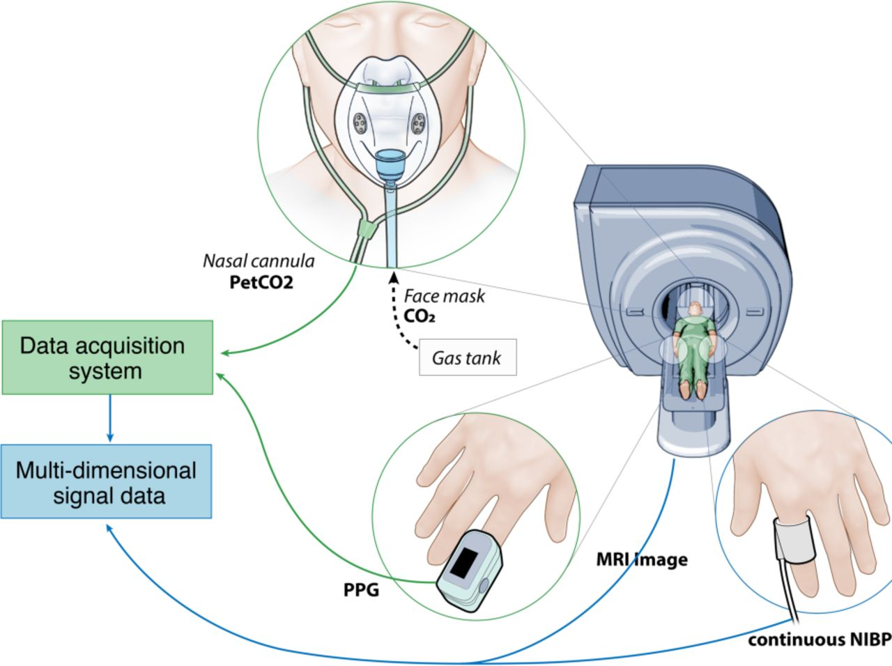
Assessment cont’d
The Hemodynamic data for the patient revealed by the assessment are;
White Blood Cells-7.1, Haemoglobin-7.1,Hematocrit-29.1 and Platelets-40.

Slide 10
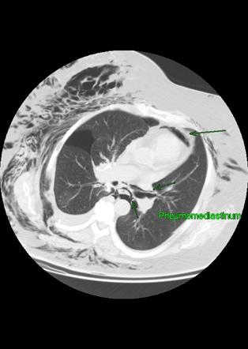
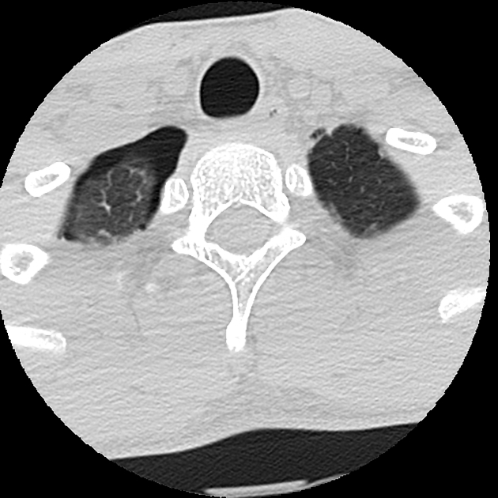
Assessment cont’d
After doing a CT scan assessment the results revealed that the Patient is suffering from a severe disease. The results revealed Pneumomediastinum, Tiny right apical pneumothorax. However, No pulmonary embolism was found.
Pneumomediastinum
apical pneumothorax

Slide 11

Assessment cont’d
The patient’s care plan entails; 8.5 ET tube size secured at 19cm at the lip. The patient is incubated 1-31-21.The Patient remains oligo-anuric. Also the patient is still dependent of continuous renal replacement therapy (CRRT) for fluid and electrolyte management. Additionally, Patient is on all 4K bath at an affluent dose of 32ml/kg/h.

Slide 12

Recommendation
To ensure Ensure patient’s effective care, it is imperative to ensure that electrolytes are within safe limits. In addition, Patient’s intake and outtake should be closely monitored. The care givers should monitor Liver Function Tests (LFTs) closely. It is essential that All nephrotox agents are avoided. Finally, Supportive care should be continued as the patient relies on them.

Slide 13

Conclusion
What can be concluded from the patient’s condition is that;
The patient is off iv bicarbonate. Additionally, the patient’s phosphate test (Phos) is acceptable. Also, the patients electrolytes are within safe dialysis bath and finally, the patient requires supportive care. Therefore it should be continued.

